Slide 1
Open EV3 program

Slide 2
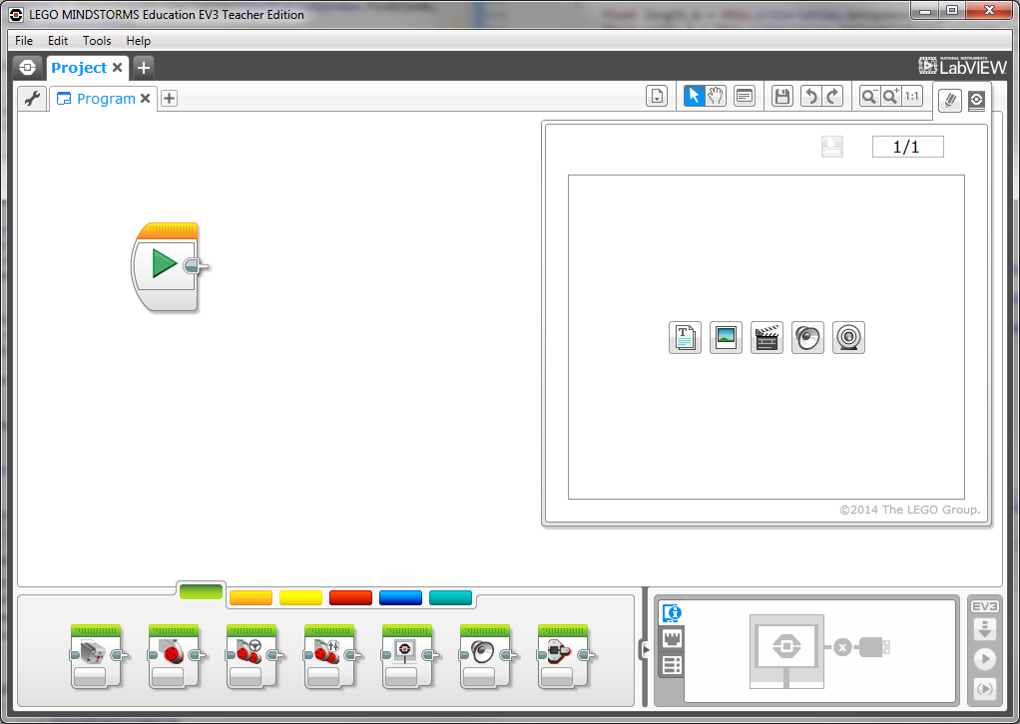

Slide 3
Change Project Name
Double Click
Change Program Name
Double Click
Make ANOTHER program

Slide 4
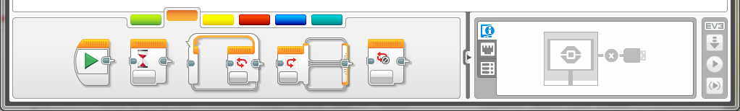
Green Does “stuff”
Move, Sounds, Lights
Steer
Orange “Thinks”
Wait
Loop
Switch

Slide 5
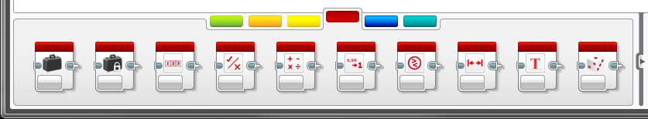
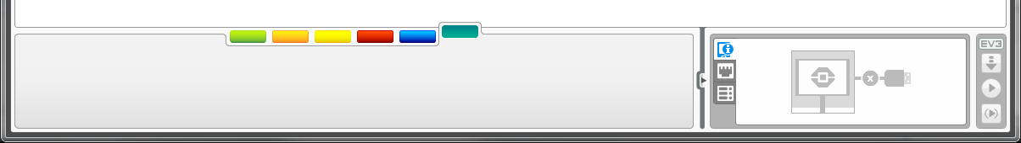
Red Does “math”
Variables/compare/etc
Blue Does “blocks”
Sub routines

Slide 6
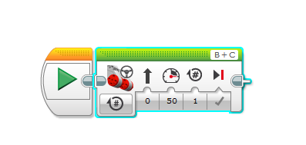

Each block has many faces
Units
How many units to rotate
Steer
Speed + Front/Back
Changed to “ON”

Slide 7



Why?
Would you ever turn the motor on “Forever”?
Then we can interrupt it based on sensors/time/etc…
How many units to rotate
What are these letters/ numbers for?

Slide 8


Use Sensors!!
We’re using a TOY not a precision instrument so don’t expect precision

Slide 9
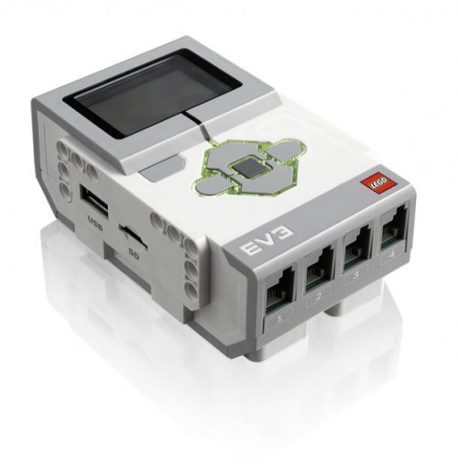
Building LEGO® EV3
USB Port for Connection to Computer
Motor Output Ports
LCD Display Screen
Navigation Buttons
Memory Expansion
Sensor Input Ports
Notes:
§ EV3 “brick”
· Have students compare these to human capabilities (brain)
· Controls motors, lights and LCD screen based on instructions and sensory input

Slide 10
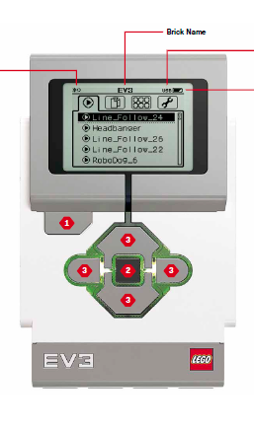
Your program will be here after you download
PANIC!!!

